Slide 1
“Healthy Minds, Healthy Schools”
To:
Jim Marks,
New York State Department of Education
Policy Proposal
By:
Aleta Garrett
Payton Neufelder
Isabella Gutierrez
Notes:
mandates social workers, resources to
better aid students and guide teachers to improve overall
wellness in public schools

Slide 2
Identify the problem
Proposed policy:
The proposed policy, “Healthy Minds, Healthy Schools” would improve teachers’ mental health and wellbeing by mandating that schools add more social workers to help students with mental health education and take the burden off teachers. A radical change in the implementation would be to propose an assigned number of social workers per student population per teacher population.

Slide 3
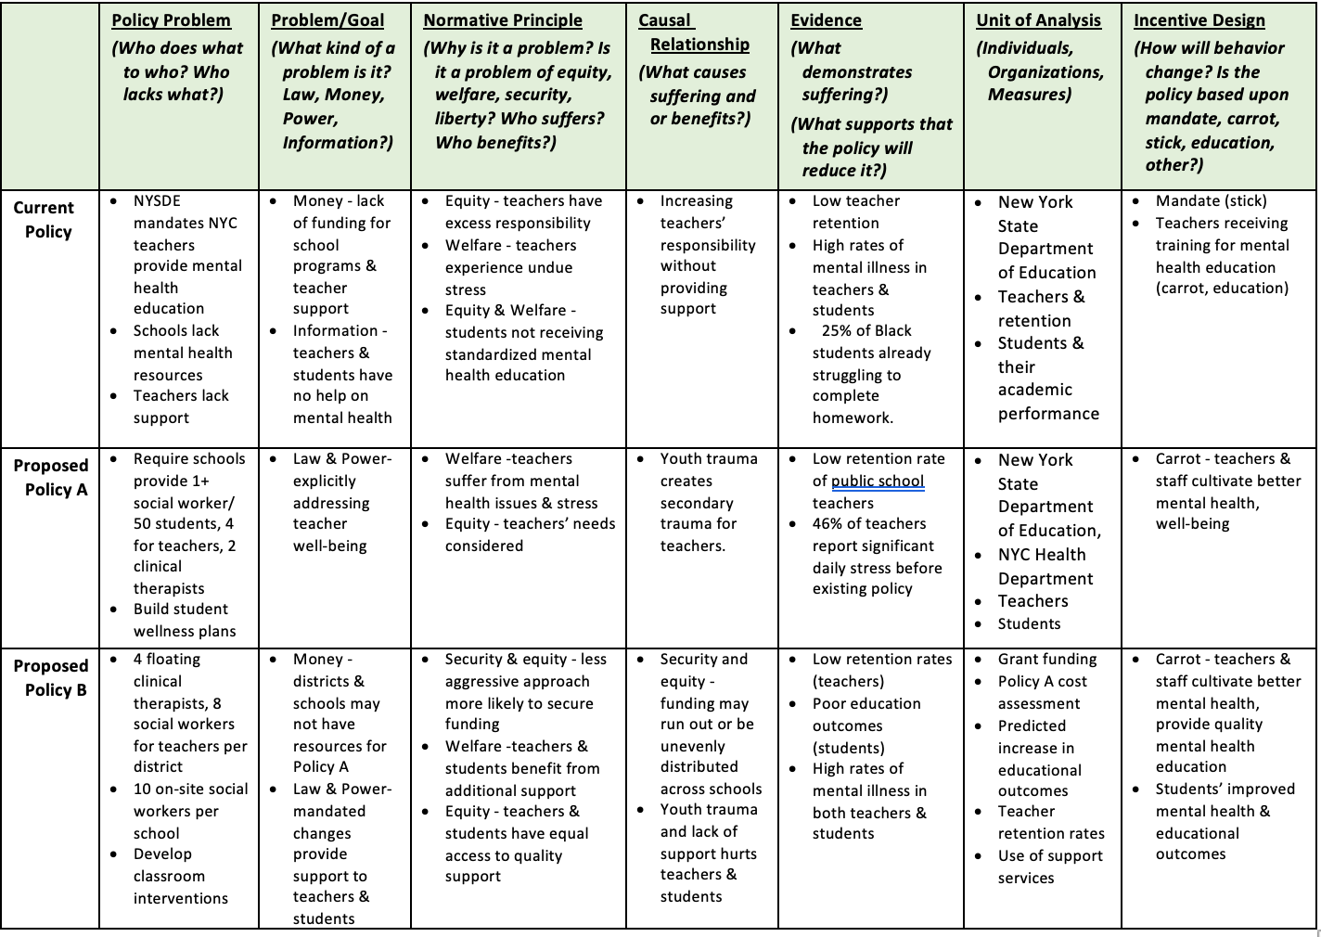
Defining the problem
Problem Definition Table

Slide 4
Act on a Plan
Current Implementation Plan:
To provide more social workers to take the workload off of teachers.
The main goal is to help teachers. This can’t be successfully done without providing more resources
(i.e. a request for more social workers) to put their attention to the students and taking the Mental Health curriculum obligation away from teachers.

Slide 5
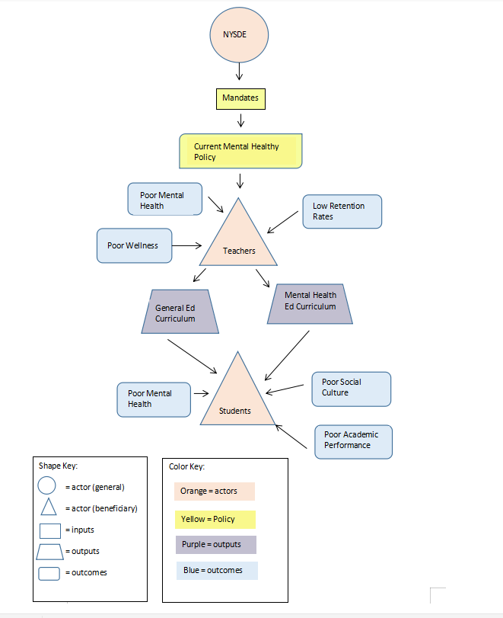
System Diagram: Current System

Slide 6
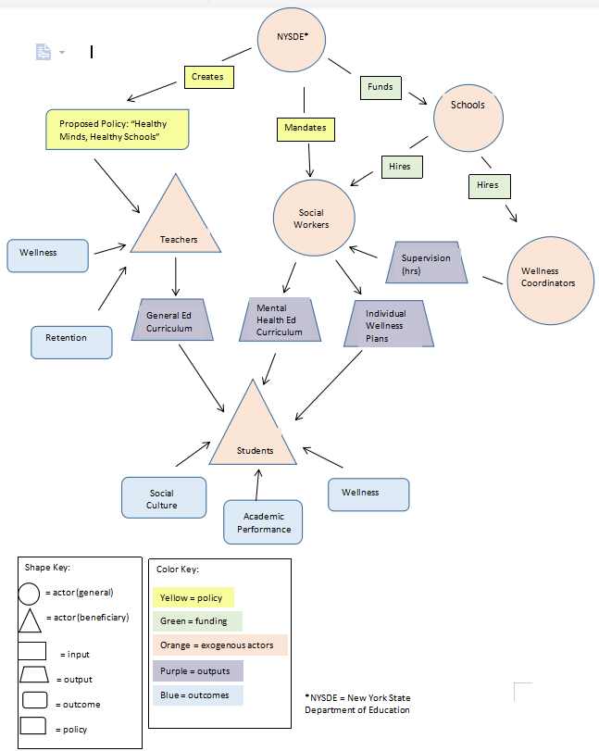
System Diagram: Proposed System

Slide 7
Portions of the Evaluation Plan
The Logic Model
Represents inputs, activities, outputs, and outcomes of proposed policy plan.
The Performance Rubric
Displays whether or not key characteristics of the policy plan are highly effective, effective, somewhat effective, or ineffective

Slide 8
Logic Model
INPUTS | ACTIVITIES | OUTPUTS | OUTCOMES
Propose policy that plans to work on the specific grounds. | A set number of social workers are assigned to each school within each district. | After proposing more social workers, this allows for teachers to not have to directly deal with students’ wellness issues, trauma etc. that they are less trained in. | With the aided help of social workers, teachers can be allowed to focus on their directed teachings rather than more particular mental health education.
Policy Makers set a plan to implement | Who will officially mandate: Governing bodies and New York State Legislators/lawmakers will need to mandate this law in accordance with the New York State Department of Education (NYSDE). | This policy would need to be proposed or put forward by policy makers but could get momentum from policy builders focused specifically in Education policy, It would need to get attention and help from unions as well as other education entities. | Another beneficial government agency that might hold some responsibility in helping to push this policy to be mandated is the CDC (Center for Disease Control and Prevention) who are in charge of Physical and Mental Health / Disease control nationally, therefore have some say (as well as information intake), on health benefits and dangers to students in schools K-12.
The breakdown by school: Once the policy is mandated in schools, there will be a designated social worker assigned to every 50 students. | The job position will require there be one head social worker (within 3) who's in charge of every 3 social workers, to make sure they are following through with their assigned work, their student groups etc. | The head social workers will also meet with a select amount of teachers per month. (1 social worker per 50 students, 2 training sessions per semester) | Meetings will take place to insure that the students are coordinating and following through on meetings with their designated social workers and vice versa).

Slide 9
Performance Rubric | Policy Implementation | Key players in policy mandating | Breakdown of implementation plan by school
Highly effective | Policy implementation goes smoothly with policy goals achieved | Those in charge of implementation (mainly the New York State Department of Education) are fully on board with the policy as well as other education entities. | The goals of the policy (social workers increased per school as well as head social worker) are successfully implemented. Program is proved to be inciting change.
Effective | Policy is implemented with minor adjustments made to the policy. | The NYSDE decides to implement. | Program is running smoothly and almost all if not all parts of school implementation are running.
Somewhat effective | Policy needs to be changed but is still able to be set in motion | The NYSDE has some issues with policy but are willing to negotiate | Program implementation needs some adjustment but schools are still able to obtain social workers.
Ineffective | Policy implementation is disrupted or does not go as planned | The New York State Department of Education finds error in policy implementation. | Number of Social workers can’t be raised per school due to budget or other* see Data Table

Slide 10
Look at the Results
The following data table that you will need to evaluates potential success of our policy proposal as well as intended performance goals per aspect of the proposed policy.
What are the struggles, implications for students, & recommendations for the current policy plan

Slide 11
Data Design Table
Types of Data | Measure | Who Collects | How is it collected | Reporting frequency | Performance goal
Policy Implementation | If this policy is implemented, allowing for more social workers in school will cost money, so the main measure outside of convincing policy makers is covering budget. | NYSDE mandates the policy and the school itself monitors social workers put in place. | Successful implementation can’t be analyzed successfully until other data aspects of implementation are complete. | Discovering whether policy implementation actions are successful depends on both policy maker actions, overcoming obstacles, and accuracy of curriculum. | If it can be proved that social worker aid can ease burden on teachers, therefore bettering their teaching and allowing for better wellness of students, then this policy plan will be a net benefit if implemented.
Details on who will mandate the policy. | Measuring social workers per district along with curriculum mandated will be up to the NYSDE and others to mandate within schools. | Deciding on stricter aspects of the policy is up to the schools once implemented. | Collected by school via surveys as well as annual check-ins. | Which districts get what: Depending on resources, deciding for districts when/what/where (like which districts specifically may need more help, funding etc. then others.) is a timely process. There may be a rationale for why certain areas need to have more etc. | To overcome obstacles. For example, since people don’t want to spend money on more social workers (or extra mental health resources for schools,) this along with budget on the policy becomes an obstacle
Breakdown of policy by school | Social workers will provide Mental Health curriculum.. Things like the ACE(Adverse Childhood Experiences) score testing and other extensions will rely mainly on problem discovery leading too then aiding students’ well-being. | They will have courses and curriculum (most likely on computers or handheld devices) that will be provided to them. | The social workers will provide Mental health curriculum which may include things like check-ins, trauma informed learning etc. | Students will work with a social worker over a designated time period. | Students and social workers will have check0ins with superiors. With the main work revolving around improving students’ well-being.

Slide 12

Mental Health and the Teaching Profession
Presented by Aleta, Bella, Payton
Struggles, Implications for Students, & Recommendations

Slide 13
Statement of Problem
Teachers are overworked and under-resourced, leading to high levels of stress compared to other professions (Busby, 2019).
A study by the Organization for Economic Cooperation and Development found that American teachers but in 1,000 hours of instruction time per year.
Teaching is a highly emotional profession, as teachers connect with students on an emotional level and are often exposed to students’ emotional struggles (Jenning and Greenberg, 2009).
Adding in other stressors, such as meeting standardized test score benchmarks, lack of autonomy over curriculum, and lack of administrative support this creates a recipe for burnout and a cascade of consequences for the entire classroom.

Slide 14
Personal Narratives
Cachero, 2019 published an article that included personal narratives from teachers struggling with the demands of their teaching jobs. The stories of two teachers, resonate with the issues we will describe in this presentation.
Holly Beth, a teacher in Louisiana, was diagnosed with depression and anxiety and prescribed medication due to the pressure she felt.
Victoria Wang, a kindergarten teacher, describes feeling overwhelmed with her students, stacks of paperwork, and lack of institutional support.
Notes:
Holly Beth had already experienced depression at periods in her life, but never as severe as when she was teaching and never requiring medication. The burnout she felt severely exacerbated her existing mental health issues.
Victoria remembers breaking down and crying in front of her kindergarten class on a number of occasions. She felt that she was failing and she could not maintain her mission in becoming a teacher in the first place.

Slide 15
Selected Terms from the Literature
Stress: an uncomfortable feeling one feels when they cannot adapt to changes related to their job or personal life (Cox, 2000).
Depression: considered a mental disorder that profoundly affects the quality of one's life, and in severe cases, an individual will not be able to function in life. It includes prolonged feelings of sadness and hopelessness as well as a decrease in motivation. (Stocker, Jacobshagen, Krings, Pfister, and Semmer 2014).
Burnout: essentially high-stress levels that do not improve over time in the workplace, which ultimately leads to low productivity and, eventually, disconnection from the job. It has been defined as a chronic occupational stress syndrome.
Well-being: a healthy state of mind that equates to being happy.
Emotional exhaustion: the state of being emotionally worn out due to stress (Cafasso, 2019).
Trauma: person experiences some event such as abuse, assault, or war, to name a few that results in a person's mental and physical state to be threatened (Terr, 1991).
Notes:
Read these as terms that will be mentioned throughout the presentation that are important in that they help support the later recommendations we will make. Then read through the definitions as listed.

Slide 16
Causes of Teacher Burnout
Overwork: the sheer number of hours teachers must work between in classroom time, lesson planning, communicating with parents, and other administrative tasks.
Lack of administrative support coupled with high standards and low autonomy over curriculum.
Responsibility for students’ emotional stressors and lack of proper support structures for this.
Notes:
Burnout is a condition that occurs when people are experiencing extreme stress and a lack of support in their work environment. Teachers are severely overworked when one factors in all of the additional administrative work that teachers must complete. There is also often a lack of support from the administration, and a lack of open communication between school leadership and teachers as well as between teachers which makes them feel isolated in their stress and challenges. All of this to come to the point that administrations often impose strict curriculums and standards to standardized test scores for students to achieve. This adds to the burden that teachers feel while stripping them of autonomy, all of which contributes to their feelings of burnout.
Additionally, teaching is a very emotionally exhausting profession. Teachers must keep their own emotions in check while forming individual and emotional connections with students to further their well-being. Schools also do not offer support for teachers emotions which makes dealing with student’s emotions more challenging when teachers are dealing with their own negative emotions.

Slide 17
Impacts on Educators
Stress 🡪 Burnout 🡪 Mental Health Struggles
It is important to note that stress and burnout do not necessarily cause mental health struggles such as anxiety and depression, but it is possible especially for those who have experienced them before.
Notes:
Increased feelings of stress related to the work place leads to teachers feeling burnout, a condition in which leads to dissociation and dissatisfaction from the job overtime. Human service work is exhausting, and as teachers feel unrelenting levels of stress they may go on to develop mental health struggles. The most common mental health struggles related to burnout are anxiety, depression, and post traumatic stress disorder and related trauma. Those who have experienced mental health issues previously are more susceptible to those related to burnout.

Slide 18
Absenteeism & Low Retention Rates
Burnout can lead to absenteeism and low retention rates- especially for new teachers and those in Title I schools.
Absenteeism: increase in days off from the workplace due to stress, depression, and burnout among other causes.
  Most prevalent in schools with high rates of poverty and more challenging work environments.
  Leads to attrition and increased turnover- especially for early career teachers and teachers of color (Carver-Thomas and Darling-Hammond, 2017).
  Decreased stability for students.
Notes:
When a teacher feels burnout and dissociated from work, and especially when they are experiencing the throws of mental health struggles, they may feel less associated with the social justice reasons they may have chosen to pursue teaching in the first place. This can lead to increased absences from work, known as absenteeism. In extreme cases it leads to teachers leaving the profession leading to high attrition rates, which is a problem for teachers all across the nation. This is especially prevalent among early career teachers, and teachers of color. This creates decreased stability for students which is particularly damaging for students with special needs, those who are already experiencing mental health issues, and students who generally need extra support. These impacts are most deeply impactful in inner-city schools with high levels of poverty, where the conditions are most stressful and most often lead to absenteeism and attrition and where students often need the most support.

Slide 19
Changes to Classroom Environment
When teachers are emotionally well, they are able to create a classroom environment that fosters this kind of well-being in their students.
Optimal classroom includes:
  Low levels of conflict
  Appropriate expressions of emotion by all
  Respectful problem-solving
  Individual attention to students’ needs.
When teachers are unable to do this due to their emotional state, students and the overall classroom environment are disrupted.

Slide 20
Impacts on Students: Burnout Cascade
The Burnout Cascade refers to the way a teacher’s burnout impacts students and the classroom environment.
When teachers cannot create lesson plans and an environment that fosters students’ academic and personal growth, students display less on-task behavior and an increase in behavioral disturbances.
When teachers are experiencing burnout, they cannot manage these classroom disturbances effectively which leads to an increase in classroom disturbances and burnout which feed off each other negatively.

Slide 21
The Commodified View of Education
The commodified view of education is a big part of why teacher’s emotions go largely ignored- and this ignorance is what causes the in-classroom impacts on students.
Commodified view of education (Takayanangri, 2016):
  Teachers are service providers, with students being primary customers.
  Parents and the community at large are secondary consumers.
  Emphasis on how teachers can best serve their ”customers” rather than on building a symbiotic relationship- which is essential for the most optimal classroom environment.

Slide 22
Recommendation
If the budget allows for it, implement Wellness Coordinators for the teachers. Though the policy mainly focuses on adding in more social workers, it still doesn’t fully account for teachers' mental health or wellness needs directly.
Continuing, Wellness Coordinators can work with social workers. This accounts for students' wellness needs through social work curriculum as well as one-on-one meetings for teachers’ needs.
Crisis counseling on more traumatic issues can be issued into the curriculum, based on a students ACE score (adverse childhood experience), what they are taught and the resources they need might vary by district.

Slide 23
Additional Recommendations to consider:
Continuing education on stress management and prevention.
Conflict resolution and communication training for students and teachers.
Transformational leadership training for the administration (Walsh, Dupré and Arnold 2014) .
  Leading by example when it comes to prioritizing well-being.
  Increased communication between school leadership and teachers.
  Creation of open communication between teachers to increase feelings of teamwork and support.

Slide 24
Additional Recommendations to consider
Well-Being Competence Training: A collaborative course between teachers and students that takes a holistic approach to teaching techniques to maintain well-being and promote self-care.
A virtual platform for students to make it easier for them to communicate their feelings.

