Slide 1
Standards, Dropout Rates, and Increasing High School Completion Rates
Brief prepared for the Wyoming State Board of Education
Vontesha Stanfield, Anhayte Guajardo, Bella Gutierrez, Lauren McKenna
Notes:
Our brief centered on dropout rates across the state of Wyoming. In particular, the brief highlighted data that identified indicators of dropout like certain thresholds of attendance, GPA, and more, all centering on freshman year as a critical time for predicting dropout.
The brief also presented data about the likelihood

Slide 2
What Market Failures do we see in the policy brief
Equity Issue
The article depicts an “equal and adequate outcome” equity issue, in the dropout rate through statistics broken down by demographic and region.
-As noted in the brief: “A significant achievement gap exists among the graduation rates of Wyoming’s minority students.
-Since school districts are separated by region, this finding suggests that the physical or social environment of regions plays a part in hindering students’ high school completion rates in these districts.
Externalities Issue
-The brief presents alarming statistics of the economic and social costs
to society due to increased high school dropout rates.
-Additionally, the brief presents an intriguing statistic on a national scale: “raising high school completion
rates one percent for all men ages 20-60 would save the U.S.
$1.4 billion annually in crime-related costs.2”
-Government intervention is warranted here again because of the scale of the issue.
Notes:
Q1: What are the rationale(s) for government intervention – i.e. which market failures exist. Present no more than two that you think are the most critical and explain why they merit government intervention, based on the framework developed in class.
SPEAKERS NOTES:
Under Equity
Wyoming’s minority students: Native Americans graduate at a very, very low rate of 27.7%, Asians at 62%, Hispanics at 56%, and African Americans at 45.1%. Caucasians graduate at an average rate of 77.7% in Wyoming.5” These disparities are severe and do not meet a threshold of adequacy when the national average is 74.7% and the state’s average is between 76.7% and 79.5%, according to the Wyoming Department of Education in 2007.
Equity Cont.
-The achievement gaps by race and district merits government intervention, most likely at the state level, since they range across the state, and at the local level since each school district will need to identify the specific resources it needs to address its unique problems.
Externalities Issue:
Under Ext.
It reports, “approximately 75% of state prison inmates and 59% of federal inmates are dropouts,” which does not necessarily mean that being dropouts directly led them to incarceration, but the correlation is significant.
Ext Cont.
These two statistics indicate that government should have a vested interest in raising high school completion rates.

Slide 3
What are our proposed government policies to address Market Failures?
Subsidies (to correct for Equity)
-The education department and or school can provide subsidy for low-income students that have difficult affording school fees, tests fees, other application fees etc.
-Subsidy for families to supplement transportation or lack thereof.
-There can also be subsidy provided for reduce or free lunch programs to address the equality issue.
-Tax Credits
Regulations (to correct for Neg. Externalities)
-Government can set regulations that require schools to decrease dropout through mandates. The mandate needs to be substantive so as to reach positive intended outcome.
-The regulation will address the neg ext. issue because, it will give certainty and is valuable when there's a higher risk of social damage esp in instances where dropout rates increase.
Direct Information Provision (to correct for Neg. Externalities)
-To influence student and family behavior - the government can mandate that school districts share two sets of
information with families and students: the indicators of dropout, and the statistics concerning consequences
for not graduating and completing high school.
-If the information is circulated to families and students in the beginning of their high school career specifically,
then with this mandated information, students and parents can be incentivized to work toward good attendance,
achieve goals, adequate grades, all while adhering to things like reputation and social norms.
Notes:
Q2: What are all of the appropriate generic government policies for each rationale and provide a short discussion of what they would look like in this specific case. Example: marketable permits, taxes, regulation. Then permits for what exactly; tax on what exactly; regulations of what form on what exactly.
SPEAKERS NOTES:
Subsidies:
-The subsidy can be given in vouchers so the students educational fees will be waves.
-Many students that dropout of school are low income and one reason can be due to being unable to afford transportation to and from school, so the district can be given subsidy for students to go towards their transportation fares.
--
-We can also use tax credits to help with equality, it can be given to parents with high school age students. The credit will be based on the attendance of the student and there will be a cap placed on this tax credit so it can help the parents that need it.
Regulations Notes:
-The regulation would have to be performance standard as it will inform the school of the expected outcome such as the dropout rate needs to decrease by 5%. The enforcement would be fines
Information Provision
- The brief shares a table sharing indicators of completing high school and indicators of dropping out based on six criteria: on-track vs. off track, absences for the year, fall semester absences, GPA, semester course failures, fall semester course failures. This information is based on freshman year data, which is one of the most critical times for predicting dropout.

Slide 4
Market failures depicted in the policy brief
Neg. Externalities
We believe the brief first and foremost addresses Neg. Externalities as a key Market failure - they delve into all the negative outcomes high school dropouts will have on aspects of society and the countries economy including examples such as: higher unemployment, earning lower wages, more likely to be involved in criminal activity, and likely to have a greater need for public assistance, be single parents, and have children at a younger age.
Equity
The brief also identified an expressing concerns in achievement gaps between Wyoming students who are minorities, who are greatly underachieving compared to their white counterparts.
Internalities
Lastly, we believe that they also hinted at an Internalities Market Failure, because if a student makes the decision to
drop out, this not only affects society, but it also affects their future selves.
Notes:
Q3: How did your policy brief frame the question – basically, how did they answer Q1? Make sure you put their argument into the general market failure categories we used in class. Keep in mind they may or may not be ‘right’ in terms of their answer being the same as your analysis. Briefs are often written as political documents where the organization has an agenda they are trying to advance.
SPEAKERS NOTES:
Neg. Externalities:
-The brief notes that 75% of inmates are high school dropouts, and with help from the government this could ultimately raise the high school completion rates, ensure less crime related costs, raise employment rates (which contributes pos externalities to society),
Furthermore there will also then be less of a need for government programs and services, which creare more direct costs to society that tend to be more noticeable.
Equity:
-When comparing their graduation rates, Native American 27.7%, Asians 62%, Hispanics 56%, and African Americans 45.1% compared to Caucasians who graduate at an average rate of 77.7%
-The brief suggests that there’s an unequal access to resources and opportunities in the school system, that affects one group more than the other, giving the government another reason to get involved.
Internalities:
-With students navigating school at such a young age, they don’t or can’t understand the hardships, financial impacts etc. that may lie ahead for them in the future if they decide not to finish school.

Slide 5
What are proposed government policies the brief recommended to address existing Market Failures?
Regulations:
The first recommendation the brief makes is related to “regulations and requirements,” as they suggest the implementation of providing quality standards.
Though they still want to hold high schools to a rigorous standard, they want to restructure curriculum in early education, because their main conclusion is that students are dropping out because they are “bored” meaning studies should be adjusted to reflect challenges/relevance to the real world.
Implement as tracking system to monitor students believed to be most likely to drop out of school
Subsidies and waivers
The brief recommends that schools should coordinate with social and health services to
support other aspects of low socioeconomic students. This would directly address the school
equity problem as waivers would most likely benefit more minority students.
Notes:
Q4: What does your brief present as a policy recommendation(s) to address the problem? First, put their option(s) into categories based on the structure we developed in class (e.g. recommending insurance or a tax credit subsidy) And then provide a short overview of what they recommend be done. Don’t just repeat their exact description, but focus on the policy as an example of our general policies.
SPEAKERS NOTES:
Regulations:
-In their conclusion the brief suggest that the best way to fix the issue is to implement a “tracking system” that will monitor for at risk students and essentially provide them the support they need as soon as they are notified about them.
Subsidies and Waivers:
-For example, the states can subsidize testing fees for the ACT and SATs, E Transcripts etc.

Slide 6
Advantages and Disadvantages of each general policy
Advantages:
Regulations
-The new standard curriculum is the same for every school across the districts, so the argument could be made that this is an “equitable” regulation because it is “equal opportunity for all.”
Information Provision
--Much like curriculum standard, the “data tracking systems” that the government wants districts to implement, would be similar across districts, so the updated technology monitoring for “at-risk” students should be a further advantage.
Disadvantages
Regulations
-Not all students perform or learn at the same level. By enforcing that everyone throughout districts is to follow a certain curriculum (especially one that is set to increase in rigor), this may actually discourage students from attending school.
-Doesn’t allow for flexibility creativity of teachers personal curriculum ideas
-Unclear who is setting the standard
Information Provision
-Teachers need to be updated and understand all aspects of the “data tracking systems.”
-Data systems cannot account for what's going on at home.
-Inputting data systems may come at a financial disadvantage.
Notes:
Q5: Based on the class discussion of limitations or advantages/disadvantages of each general policy, what problems do you see potentially existing with the use of this policy? In most cases, a policy brief will not go into these details, and certainly not the potential problems with their recommendation, so you will need to analyze what might go wrong. Discuss any design decisions made that would minimize the potential problems as well as the problems that still remain. Example: They are recommending performance regulations (a form of quantity regulation), where firms will be in compliance if they do XX. Performance regulations appear appropriate in this case because there is a weak understanding of the causal relationships between any interventions and the final goal. If government specifies the final goal, the firms will have a motivation to discover the most effective and efficient methods to reach those outcomes.
SPEAKERS NOTES:
Advantage to Regulations:
When it comes the “regulation” of a new curriculum standard with the “attachment, attendance, and achievement” goals in mind, this is an advantage only if schools can follow through, because it won’t allow for mismatch in curriculum throughout all of the Wyoming public education systems.
Advantage to Info Provision:
Same as Curriculum standard, the data tracking systems (that input 3 A’s) should yield equal outputs across all districts
Disadvantage to Regulations:
This design decision although comprehensive in how it plans to help students, does not go into specifics on how they would enforce regulations, or what they will do if the plan doesn’t work for every type of student.
If there are teachers who what to be more creative in their teaching style, a strict or more rigorous design for teaching might deter them from their own individual teaching styles.
Disadvantage to Info Provision:
-If teachers are not comfortable using the systems or don’t understand the statistics behind it, it might do more damage than good. The tracking can only be equitable if teachers can also relay issues going with students over to parents.
-The “data systems” though carefully monitoring student activity while at school, doesn’t account for what goes on in students lives outside of school (other factors become present here that could affect negatively equity, such as mental health issues, which the brief gives no mention of).
-Are they admin feasible? Or is putting new data systems in ultimately just more costly?

Slide 7
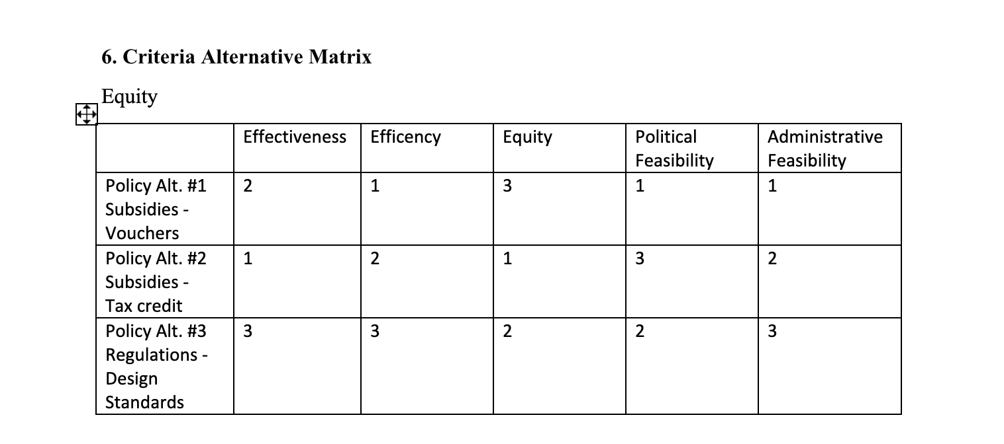
Notes:
Q6: Complete a Criteria Alternative Matrix based on your analysis in Q1 and Q2. Looking at the information in your matrix, for each criteria rank order (1 being highest) the policies. Give a brief explanation of the reasons for your rankings.
SPEAKERS NOTES:
Effectiveness- The tax credit will likely be most effective because money is a motivator, especially for families who are vulnerable to dropout, often families in poverty. The credit is given based on a certain number of days attended, so hopefully families will be motivated to do what they can to get their students to school consistently, which decreases their likelihood to dropout.
Efficiency – Vouchers are most efficient since there are no monitoring or enforcement costs since they are voluntary and can only be used for a specific purpose. The tax credit relies on the tax system already in place, though a more equitable tax credit would have multiple distributions throughout the year to help low income families more consistently, which may require the IRS to update its technology and capabilities, which would be costly. Lastly, regulations, in this case, design standards, will be most costly due to the monitoring and enforcement costs. Whether the government uses a police patrol or fire alarm method, both will require personnel and data tracking resources, which will be costly.
Equity - The tax credit is going to maximize freedom of choice by giving people money back with no limitations, so we have ranked it first. The design standards are equitable from an equal access - equal inputs standpoint, though we addressed the limitations of this overall in the effectiveness criteria. The vouchers are also equitable from an equal inputs perspective, yet they err more on the motivation of creating a positive externality since they specify which purpose the currency they’re receiving must be used for.
Political Feasibility – The vouchers are the least likely to receive political pushback because statistics show that, the more students attend school consistently and prepare for college, the better off society is. Because the vouchers can only be used for these education-related purposes, the program should receive the most support because it can only benefit society overall. With regulations, there is a possibility that the standards set are seen as either too elite or not high enough. The schools discussed in the brief vary greatly in their performance, which indicates that their need for resources and the types of resources that they need also probably vary greatly.
Administrative Feasibility – The voucher will likely be the most feasible because it is voluntary, doesn’t require a lot of manpower, nor monitoring since it is currency used for only a specific purpose. The government really only needs to create the vouchers and verify who qualifies for them to implement this system. The tax credit is the second most feasible since the tax system already exists and claiming the credit is voluntary. This method will also require the government to verify that those who claim the credit qualify and it will have to distribute the tax credit. The design standards, as regulations, are going to require more effort to monitor and enforce because they will not be effective unless there is a substantial threat of penalty. In the case of a school system, this penalty might be having funds withheld.

Slide 8
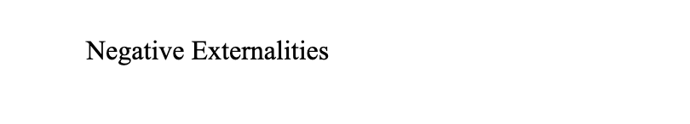
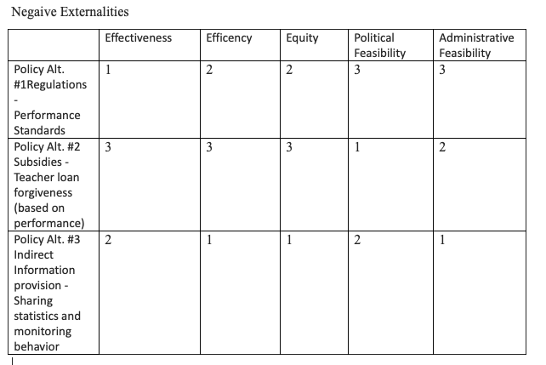
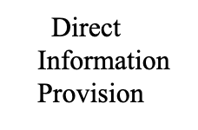

Slide 9
Based on CAM table, which policy(s) would we recommend:
To address Negative Externalities
In the case of addressing negative externalities we recommend regulations through the idea of the briefs measured
performance standard.
- By having schools providing a certain outcome as the issue is high school dropout rate, the government can use the design standard to help high school dropout rates as they can tell school a list of things to do but it may not have an effect on the dropout rate. The government needs to set the standard in the form of outcome to deal with high school dropouts.
To address Equity - we recommended subsidies in the form of vouchers.
-Subsidies can really help low income families addressing parts of the equity issue that schools may not always account for
(such as standardized test fees, transportation, test prep fees, school lunch programs and more)
To address Negative Externalities
-We recommended Indirect Information provision through sharing statistics with parents while
monitoring behaviors of students, to influence parents
-
Notes:
Q7: Considering your analysis in the CAM table, which policy(s) would you recommend and why? You could include two policies at the most. Discuss how you came to this conclusion. You can also consider here if you would like to have a combination of policies.
SPEAKERS NOTES:

